Slide 1



Walchand College of Engineering, Sangli
App Based Control and Monitor Using LPC2138
Course: Embedded System Design
Created by Group 7

Slide 2

Presenters:
Name | PRN
Harsh Bandgar | 21410045
Rajwardhan Vichare | 21410058
Vishvajeet Jagtap | 21410059
Aditya Pachore | 21410066
Guided By: Mr. S.R. Khedkar

Slide 3


Table of Content
Introduction
Objectives
Components Required
Circuit Diagram
Block Diagram
Algorithm
Advantages
Conclusion

Slide 4
Introduction
The "App Based Control and Monitor Using LPC2138" project embodies a sophisticated blend of hardware components, including the LPC2138 microcontroller, L293D motor driver, and HC-05 Bluetooth module, to establish a robust and user-friendly interface for controlling a set of four motors through a mobile application.

Slide 5
Objectives
1. Configure HC-05 and LPC2138.
2. Configure L293D and LPC2138.
3. Design and implement a user interface for vehcle control using a
Bluetooth Application.

Slide 6
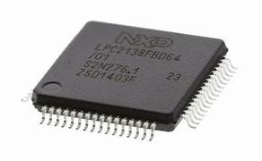
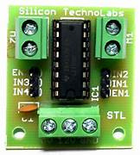
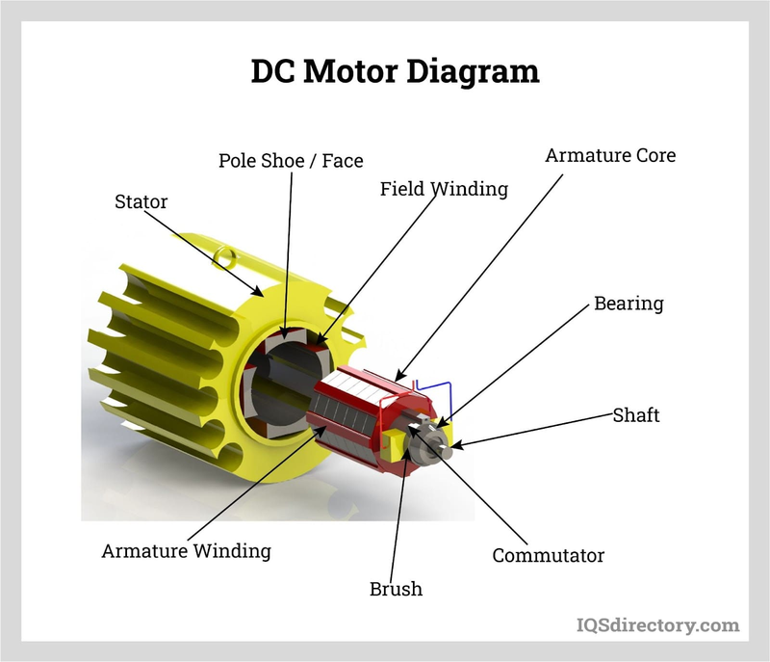
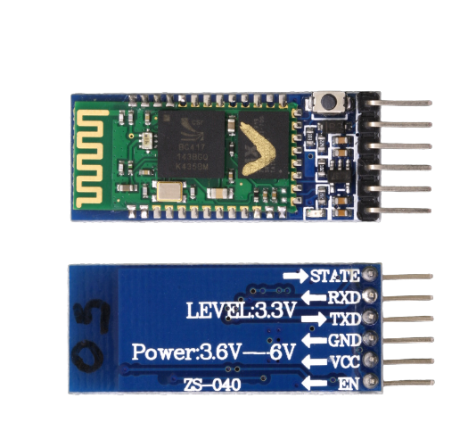
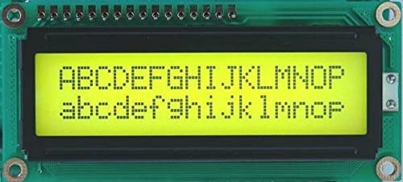
Components
HC-05 Bluetooth Module
L293D Motor Driver
LPC-2138
DC Motor(12V)
LCD 16*2

Slide 7
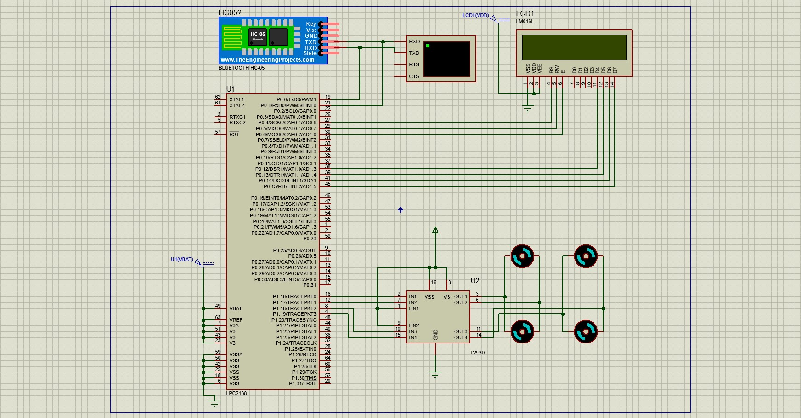
Proteus Circuit

Slide 8
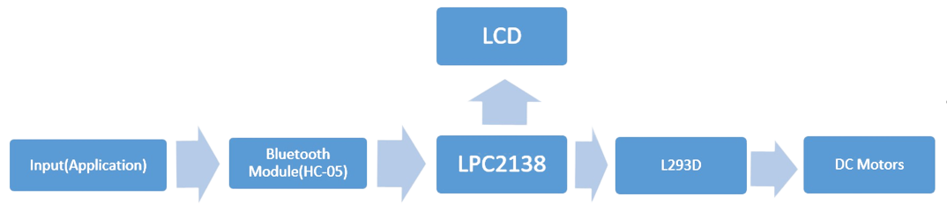
Block Diagram

Slide 9
Algorithm
Initialize CPU clock using PLL for desired frequency.
Set up the data and control pins for the LCD.
Send initialization commands to set up the LCD in 4-bit mode, specify display parameters, and clear the display.
Configure UART for serial communication.
Continuously monitor for incoming characters over the serial interface.

Slide 10
Algorithm
Based on the received character:
Set the corresponding output pins to control the movement of the vehicle (e.g., forward, backward, right, left, stop).
Update the LCD with the corresponding action message (e.g., "Moving Forward", "Turning Left", "Stopping Vehicle").
Configure GPIO pins for interfacing with the LCD and vehicle control in the main function.
The program stays in the main function, continuously monitoring for new serial commands to control the vehicle and updating the LCD accordingly.

Slide 11
Why HC-05?
Bluetooth Technology Overview
Features
Compact Size
Energy-efficient
Versatility
Ease of use
Compatibility with Microcontrollers

Slide 12
Why HC-05?
Serial Communication
Range and Data Rate
Cost-Effectiveness
Applications
Community and Documentation Support
Comparison with Other Modules

Slide 13
Conclusion

Slide 14
Future Scope:
i)Efficiency Monitoring
ii)Closed-Loop Control
iii)Long Range Controls

Slide 15
Thank You

